Slide 1
Information System
ITEC-522
First Semester Third Year
Information Technology
Dr. Khalil-ur-Rahmen Khoumbati
Professor
Department of Information Technology
Faculty of Engineering and Technology
University of Sindh, Jamshoro
Khalil.khoumbati@gmail.com
Week # 4

Slide 2
Business Processes and Information Systems
Business processes:
  Workflows of material, information, knowledge
  Sets of activities, steps
  May be tied to functional area or be cross-functional
Businesses: Can be seen as collection of business processes
Business processes may be assets or liabilities
© Prentice Hall 2011

Slide 3
Cont.
Examples of functional business processes
  Manufacturing and production
    Assembling the product
  Sales and marketing
    Identifying customers
  Finance and accounting
    Creating financial statements
  Human resources
    Hiring employees
© Prentice Hall 2011

Slide 4
Cont.
Information technology enhances business processes in two main ways:
  Increasing efficiency of existing processes
    Automating steps that were manual
  Enabling entirely new processes that are capable of transforming the businesses
    Change flow of information
    Replace sequential steps with parallel steps
    Eliminate delays in decision making
© Prentice Hall 2011

Slide 5
Enterprise Applications
Business Processes and Information Systems
Examples of Functional Business Processes
Manufacturing and production: Assembling product, checking quality, producing bills of materials
Sales and marketing: Identifying customers, creating customer awareness, selling
Finance and accounting: Paying creditors, creating financial statements, managing cash accounts
Human Resources: Hiring employees, evaluating performance, enrolling employees in benefits plans

Slide 6
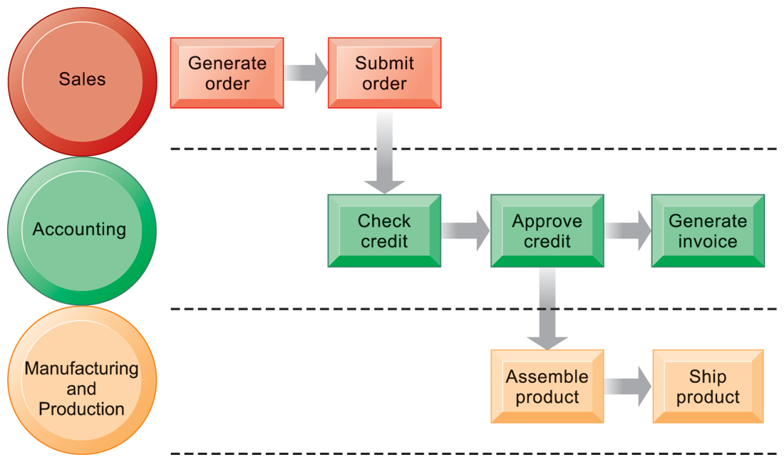
Order Fulfillment Process
The
Fulfilling a customer order involves a complex set of steps that requires the close coordination of the sales, accounting, and manufacturing functions.
© Prentice Hall 2011

Slide 7
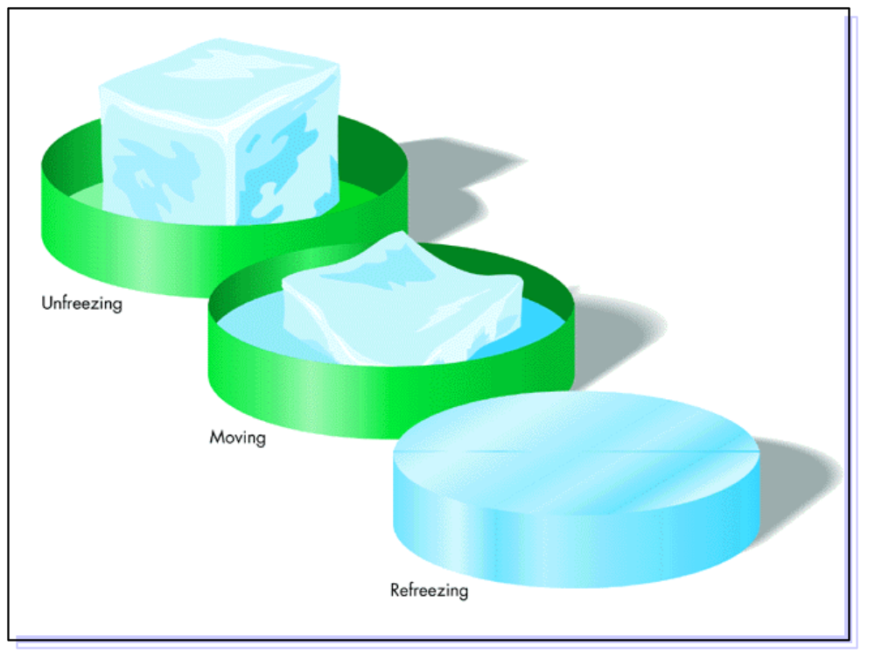
Organizational Change
Lewin & Schein
Create receptive climate(there is a better way to operate)
Learn new methods, obtain commitment
Reinforce, reward new behavior

Slide 8
Reengineering
The radical redesign of business processes to achieve a significant breakthrough in business results
  Delivery time
  Product & service quality
  Costs, revenue & productivity

Slide 9
Reengineering
Employee resistance
Employees must understand benefits
Old rules must be challenged
  Examples
  Size of orders
  Credit approval
  Decision-making level

Slide 10
Reengineering
Examples of reengineering initiatives
  Simplifying work processes
  Combining several jobs into one
  Outsourcing ancillary processes
  Entering new business areas
  Establishing new management structures
  Renovating technology systems

Slide 11
Reengineering vs.
Continuous Improvement
Strong action to solve serious problems
Top-down-driven by senior executives
Broad in scope; cuts across organizations
Goal is to achieve a major breakthrough
Routine actions to make minor improvements
Worker driven
Narrow in scope; focus in a given area
Goal is continuous, gradual improvement

Slide 12
Total Quality Management
Company-wide effort to add more value
  Keen awareness of customer
  Strategic vision for quality
  Empowerment of employees
  Rewards for high quality

Slide 13
Outsourcing
Contracting with outside professional services to meet specific business needs.
  Focus on core business
  Save money

Slide 14
Downsizing
Reducing the number of employees to cut costs

Slide 15
Performance-Based Information Systems
Productivity
  A measure of the output achieved divided by the input required.
Return on Investment
  Profit or benefit as a percentage of investment
Earnings Growth
Market Share
Customer Awareness & Satisfaction
Total Cost of Ownership

Slide 16
Identifying Risks
How well are requirements understood?
Does the project require pioneering effort?
Is there a risk of severe business repercussions?

Slide 17
Leading Edge vs.
Bleeding Edge
Bleeding Edge: When failure occurs because an organization tries to be too far out on the technological leading edge
  Time-Warner’s Pathfinder portal
Leading Edge: Let competitors test the new technology first
  Microsoft Word, Excel, Access, IE

Slide 18
Justifying IS
Tangible savings (reduced costs)
Intangible savings (better decisions)
Legal requirements (reports)
Modernization (Y2K, new apps)
Pilot project (laptops)

Slide 19
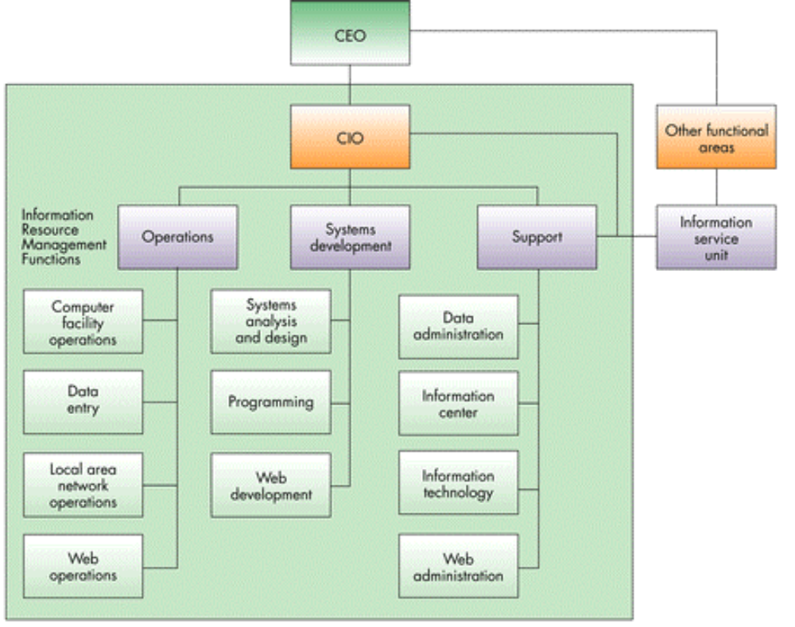
Roles and Functions in the IS Department

Slide 20
Discussion
Questions?

